Slide 1
Microsoft Power BI

Slide 2
Report Authoring and Customization with Power BI Embedding
Ted Pattison
Principal Program Manager
Power BI Customer Advisory Team (PBICAT)

Slide 3
Welcome to Power BI Dev Camp
Power BI Dev Camp Portal - https://powerbidevcamp.net

Slide 4
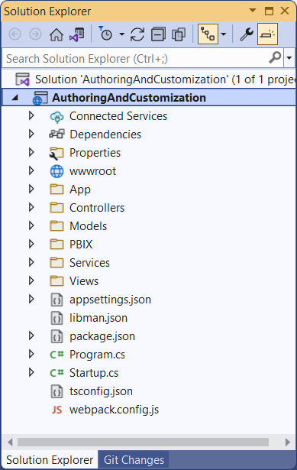
Developer Sample: AuthoringAndCustomization
Developer sample demonstrates App-Owns-Data embedding techniques
Implemented as C#/.NET6 web application which uses the Power BI .NET SDK
Download from https://github.com/PowerBiDevCamp/PBIE-Authoring-And-Customization
{F5}

Slide 5
Agenda
Initializing and Customizing Report Pages
Creating Custom Navigation with Pages and Bookmarks
Creating Authoring Experiences with the Report Designer
Creating New Pages and Adding Visuals using Code
Embedding Reports using Custom Layouts
Adding Personalization Features using Custom Bookmarks

Slide 6
Power BI JavaScript API (powerbi.js)
Power BI JavaScript API used to embed resources in browser
Client-side JavaScript API required to develop with Power BI embedding
Documentation is titled Power BI embedded analytics Client APIs https://docs.microsoft.com/en-us/javascript/api/overview/powerbi/

Slide 7
Hello World with powerbi.js using TypeScript
You can write code which program powerbi.js using JavaScript or TypeScript
Using TypeScript adds strongly-typed programming and much better IntelliSense
AuthoringAndCustomization project demonstrates programming with TypeScript
TypeScript code in project is compiled into JavaScript using webpack

Slide 8
Viewing Report Object in Chrome Dev Tools

Slide 9
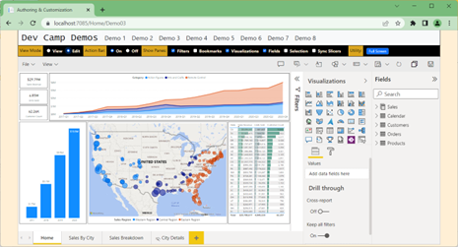
Solution Architecture
HomeController returns HTML page to browser with viewModel
Each demo page runs as a single page application (SPA)
Some demo pages require WebApi callbacks after initial page has loaded
Power BI REST API
AppOwnsDataAdmin
AppOwnsDataDB
AppOwnsDataClient
AppOwnsDataWebApi

Slide 10
Exploring powerbi.js Events
Demo01 registers a handler for all supported events
Great resource to gain better understand of which actions fire specific events
Event arguments logged to console window for easy inspection

Slide 11
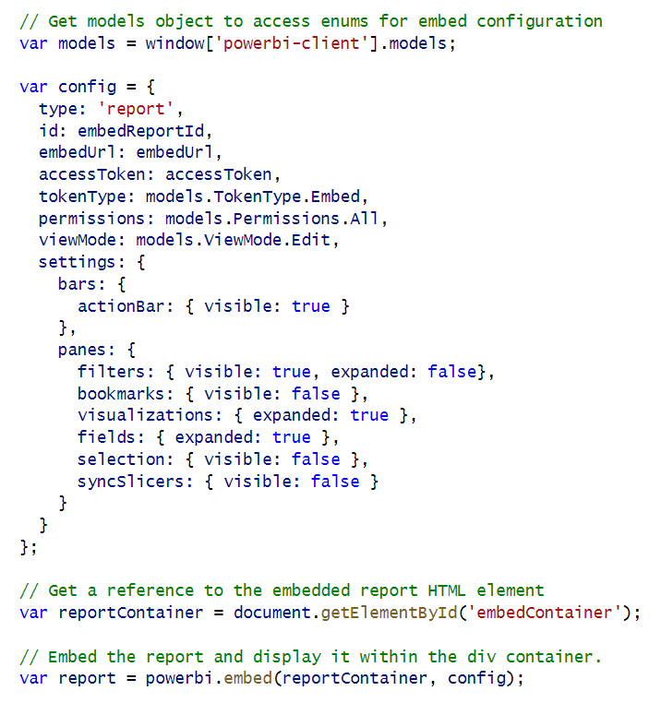
Initializing Panes When Embedding a Report
Report panes and action bar can be set in config object
Filter pane and Bookmarks pane available in View mode
Other panes only available in Edit mode

Slide 12
Showing and Hiding Report Panes in View Mode
You can hide and show panes after report has loaded using code
Show/Hide Filter Pane
Show/Hide Bookmarks Pane

Slide 13
Updating the Display Option Setting
Display Option can be set to Fit To Page, Fit To Width or Actual Size
Report settings for Display Option must be updated with a custom layout
Switch report to Fit to Page
Switch report to Fit to Screen
Switch report to Actual size

Slide 14
Agenda
Initializing and Customizing Report Pages
Creating Custom Navigation with Pages and Bookmarks
Creating Authoring Experiences with the Report Designer
Creating New Pages and Adding Visuals using Code
Embedding Reports using Custom Layouts
Adding Personalization Features using Custom Bookmarks

Slide 15
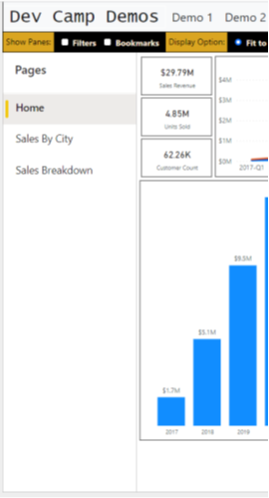
Report Navigation Settings
set navigation
left navigation
bottom navigation

Slide 16
Creating a Custom Navigation Scheme
Custom Navigation can be added using pages or bookmarks

Slide 17
Agenda
Initializing and Customizing Report Pages
Creating Custom Navigation with Pages and Bookmarks
Creating Authoring Experiences with the Report Designer
Creating New Pages and Adding Visuals using Code
Embedding Reports using Custom Layouts
Adding Personalization Features using Custom Bookmarks

Slide 18
Moving a Report into Edit Mode
Embed token requirements
To save report, ReportId in embed token must have allowEdit set to true
To perform Save As, embed token must have workspace ID

Slide 19
GetReportEmbeddingData

Slide 20
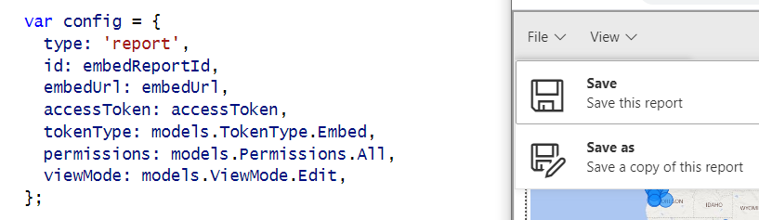
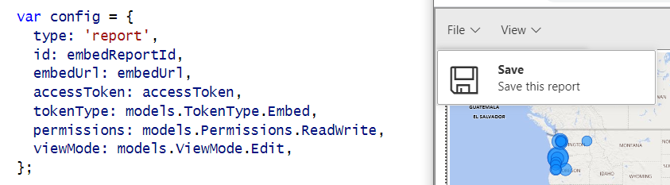
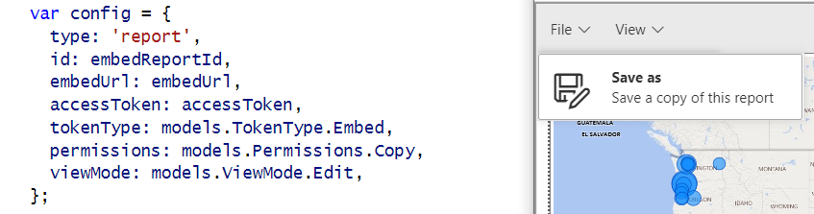
Showing and Hiding the Save and Save as Menus
permissions: models.Permissions.All
permissions: models.Permissions.ReadWrite
permissions: models.Permissions.Copy

Slide 21
Implementing the Save-As Redirect
saved event fires on both Save and SaveAs actions
Call to Web API to get new embed token with the report ID of the new report

Slide 22
EmbedTokenController Calls GetEmbedToken

Slide 23
GetEmbedToken

Slide 24
Using a Custom SaveAs Dialog

Slide 25
Saving Copy of Report to a Target Workspace

Slide 26
Agenda
Initializing and Customizing Report Pages
Creating Custom Navigation with Pages and Bookmarks
Creating Authoring Experiences with the Report Designer
Creating New Pages and Adding Visuals using Code
Embedding Reports using Custom Layouts
Adding Personalization Features using Custom Bookmarks

Slide 28
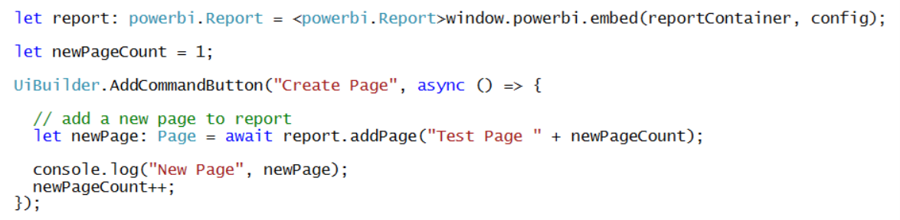
Adding a Page to a Report

Slide 29
Understanding Visual Capabilities
Visual capabilities can be queried to determine data roles

Slide 30
Defining Targets for Columns and Measures
Adding fields to data roles requires creation of column targets and measure targets
Simple example of creating a visual and adding targets for its data roles

Slide 31
Creating a Table Visual

Slide 32
Create a Column Chart Visual

Slide 33
Create a Map Visual

Slide 34
Visual Types Available for Programmatic Creation
actionButton
areaChart
barChart
basicShape
card
clusteredBarChart
clusteredColumnChart
columnChart
debugVisual
Decomposition Tree
donutChart
esriVisual
filledMap
funnel
gauge
hundredPercentStackedBarChart
hundredPercentStackedColumnChart
image
keyDriversVisual
kpi
lineChart
lineClusteredColumnComboChart
lineStackedColumnComboChart
map
multiRowCard
pieChart
pivotTable
PowerApps
pythonVisual
qnaVisual
ribbonChart
scatterChart
scriptVisual
shapeMap
slicer
stackedAreaChart
tableEx
textbox
treemap
waterfallChart

Slide 35
Agenda
Initializing and Customizing Report Pages
Creating Custom Navigation with Pages and Bookmarks
Creating Authoring Experiences with the Report Designer
Creating New Pages and Adding Visuals using Code
Embedding Reports using Custom Layouts
Adding Personalization Features using Custom Bookmarks

Slide 36
Getting the Names of Pages and Visuals
You can discover page names and visual names using Demo01 events explorer
In some scenarios, you might want to hard-code page and visual names into your code

Slide 37
Creating a Static Custom Layout
You can set x position, y position, width and height for each visual in a custom layout

Slide 38
Creating a Dynamic Custom Layout without Hard-coded IDs

Slide 39
Displaying a Single Visual
Create a custom layout that only display a single visual
Visual can be sized to full width and height of report
Use defaultLayout to hide all other visuals by default.

Slide 40
Agenda
Initializing and Customizing Report Pages
Creating Custom Navigation with Pages and Bookmarks
Creating Authoring Experiences with the Report Designer
Creating New Pages and Adding Visuals using Code
Embedding Reports using Custom Layouts
Adding Personalization Features using Custom Bookmarks

Slide 41
Adding Custom Navigation using Bookmarks
Let's start by adding navigation using bookmarks defined inside the report

Slide 42
Capturing a Custom Bookmark

Slide 43
Working with Persisted Bookmarks

Slide 44
Summary
Initializing and Customizing Report Pages
Creating Custom Navigation with Pages and Bookmarks
Creating Authoring Experiences with the Report Designer
Creating New Pages and Adding Visuals using Code
Embedding Reports using Custom Layouts
Adding Personalization Features using Custom Bookmarks

Slide 45
Microsoft Power BI
Questions?

